Slide 1
SUPERVISED BY:

Slide 2

1. Introduction
2

Slide 3
BACKGROUND
Diagnosis of diabetes in a patient is the latest research domain and there is a need to implement a computer-based solution that can diagnose diabetes based on certain measurements. Diabetes diagnosis in a patient takes time when performing tests in the healthcare laboratory.
A data science model can be implemented that can diagnose diabetes in patients without any physical test. it will require different symptoms (measurements) from the patient and will diagnose whether a patient has diabetes or not.
3
Notes:
Electronic health records (EHRs) are highly sensitive and private information related to the diagnosis and treatment of patient.
These information needs to be securely stored and frequently shared among different healthcare participants.
Improving the security and privacy of EHR systems and developing a scalable blockchain-based EHR solution is the main focus of my work described in this thesis.
In healthcare EHRs are the information related to the diagnosis and treatment of patient
Considered as highly sensitive and private information
Cancer, HIV patient long history (radiation dose)
As soon as this healthcare data become available over a network it becomes susceptible to eavesdropping and remote attacks.
EHRs are regular targets of both malicious attacks and misuse.
As sensitive and private - need to be securely store and frequently shared among participants
For EHRs the system must have good security and privacy of data

Slide 4
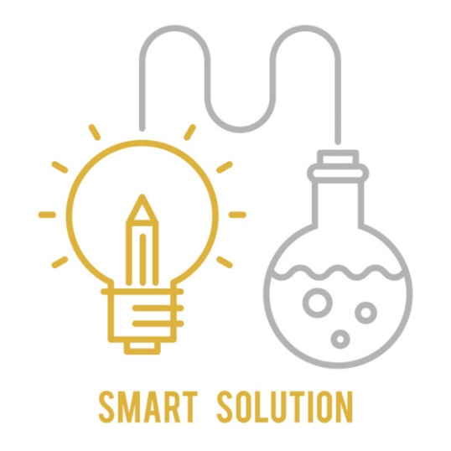
3. Methodology
4

Slide 5
MODULES OF METHODOLOGY
Major steps & modules in the Research Methodology:
Dataset Description
Data Pre-Processing
Feature Engineering and Extraction Techniques
Data Splitting
Classification Models
Performance parameters
5
Notes:
Improved security of electronic health records of patients
Protecting privacy of sensitive information
Enabling citizens to own and protect their data
More scalable solution compared to previously proposed blockchain-based EHR solutions.

Slide 6
Dataset Description
A diabetes dataset has been taken to develop the prediction model. In the dataset there are total 9 column. Among them 8 columns are ‘'Pregnancies', 'Glucose', 'BloodPressure', 'SkinThickness', 'Insulin', 'BMI', 'DiabetesPedigreeFunction', 'Age'. Which are used to predict the ‘Outcome’. ‘outcome’ column is the label column, which can be wither ‘0’ or ‘1’. ‘0’ means that the patient is not diabetic and ‘1’ means that the patient is diabetic. As the label has already been given this mean that a supervised learning model can be trained on this dataset.
6
Notes:
Improved security of electronic health records of patients
Protecting privacy of sensitive information
Enabling citizens to own and protect their data
More scalable solution compared to previously proposed blockchain-based EHR solutions.

Slide 7
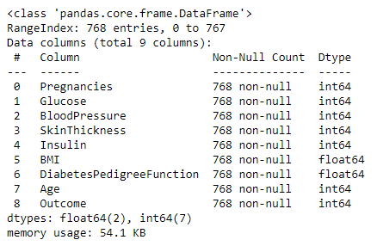
Dataset Description
Dataset contains 768 rows and 9 columns, all of them are numerical which means no label encodings will be used. All columns values are 768, which mean that the dataset does not contain NULL values.
7
Notes:
Improved security of electronic health records of patients
Protecting privacy of sensitive information
Enabling citizens to own and protect their data
More scalable solution compared to previously proposed blockchain-based EHR solutions.

Slide 8

5. EDA (Exploratory Data Analysis)
8

Slide 9
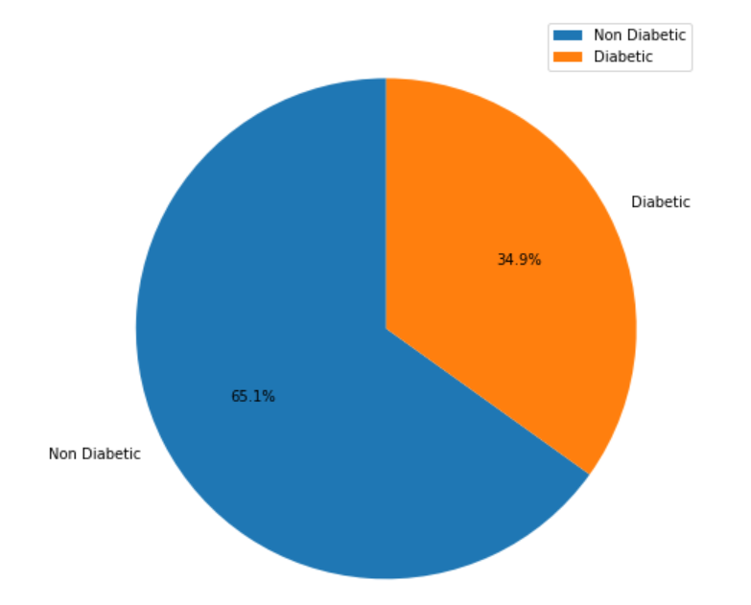
Pie Chart Representation
Above figure shows that among the dataset we are using 65.1% of them are non-diabetic and 34.9% of them are diabetic. Data is a little bit skewed to the non-diabetic side but as in the reality most of the person are non-diabetic and we are also going to implement for the real understanding so such skewness won’t make any difference. But if you are using some other data, skewness may affect your results of the system.
9
Notes:
Linux Foundation, and has received contributions from IBM
By default Kafka is the Hyperledger Fabric ordering mechanism required to establish total order of transactions.
It collects transactions from the clients, order them and group them into a blocks chained one after another.
Certificate authorities (CAs) handle identity registration and digital certificates for Fabric networks .
Entities communicating in the network identify themselves using certificates issued by one of the CAs in the network.
The entities validating the certificates are the MSPs
Modular: an approach that subdivides a system into smaller parts
TLS: Transport Layer Security

Slide 10
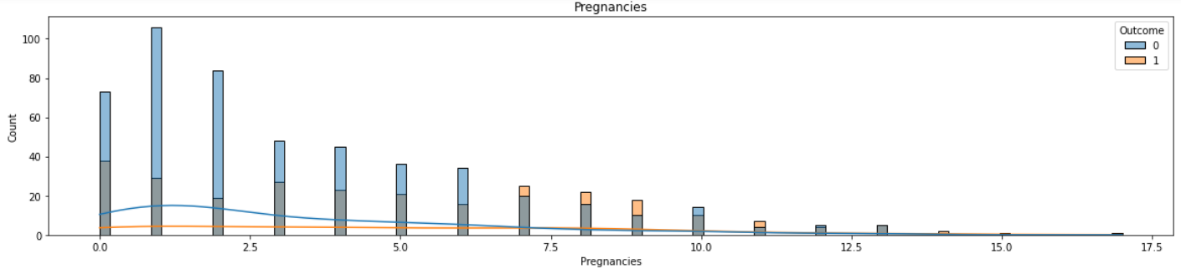
Bar Chart Representation
Above figure shows the relationship between pregnancies column and the outcome. For example, the first columns show that women who have 0 pregnancies, among them 40 are diabetic and almost 78 are non-diabetic. We can also see that with the increase in the number of pregnancies women become more vulnerable to the diabetes. After the 6 pregnancy a major difference can be seen in the dataset.
10
Notes:
Linux Foundation, and has received contributions from IBM
By default Kafka is the Hyperledger Fabric ordering mechanism required to establish total order of transactions.
It collects transactions from the clients, order them and group them into a blocks chained one after another.
Certificate authorities (CAs) handle identity registration and digital certificates for Fabric networks .
Entities communicating in the network identify themselves using certificates issued by one of the CAs in the network.
The entities validating the certificates are the MSPs
Modular: an approach that subdivides a system into smaller parts
TLS: Transport Layer Security

Slide 11
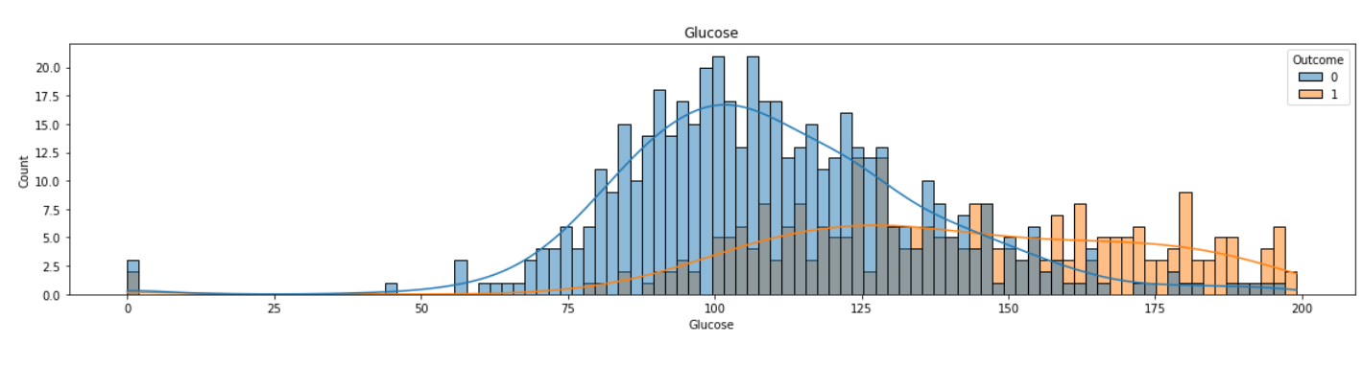
Bar Chart Representation
Above figure shows the relation between ‘Glucose’ and the ‘Outcome’ column. People who have the glucose level less than 125 are mostly non-diabetic and above 125 most of the people are diabetic. This means that the people who have higher value of glucose is vulnerable to diabetes and that the outcome is directly proportional to the glucose. Means these two columns are highly correlated to each other.
11
Notes:
Linux Foundation, and has received contributions from IBM
By default Kafka is the Hyperledger Fabric ordering mechanism required to establish total order of transactions.
It collects transactions from the clients, order them and group them into a blocks chained one after another.
Certificate authorities (CAs) handle identity registration and digital certificates for Fabric networks .
Entities communicating in the network identify themselves using certificates issued by one of the CAs in the network.
The entities validating the certificates are the MSPs
Modular: an approach that subdivides a system into smaller parts
TLS: Transport Layer Security

Slide 12
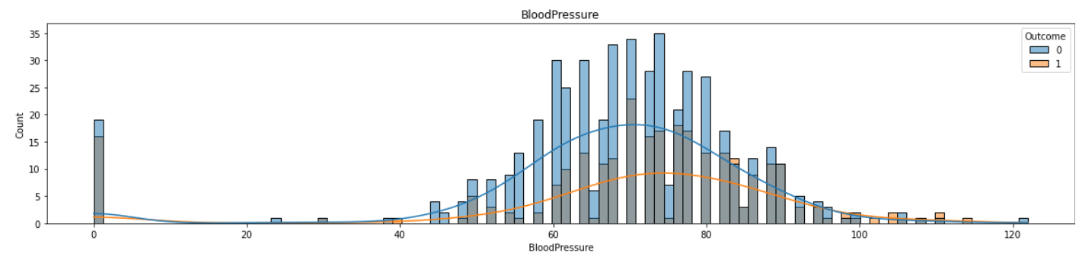
Bar Chart Representation
In the above diagram we can see that the blood pressure does not affect the diabetes much. The ratio of the overall patients is 65.1% and 34.9% same ratio can be seen in the above figure as the people who are diabetic in a range has almost similar ratio to the people who are non-diabetic. Which means that these two columns are not much correlated and doesn’t not affect much to each other.
12
Notes:
Linux Foundation, and has received contributions from IBM
By default Kafka is the Hyperledger Fabric ordering mechanism required to establish total order of transactions.
It collects transactions from the clients, order them and group them into a blocks chained one after another.
Certificate authorities (CAs) handle identity registration and digital certificates for Fabric networks .
Entities communicating in the network identify themselves using certificates issued by one of the CAs in the network.
The entities validating the certificates are the MSPs
Modular: an approach that subdivides a system into smaller parts
TLS: Transport Layer Security

Slide 13
6. Results
13

Slide 14
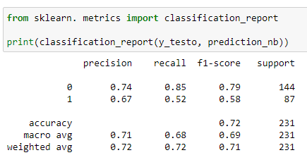
NB FINDINGS
It is shown that among all the patients who were non-diabetic trained model has predicted 74% as non-diabetic and other 26% are predicted as diabetic. Similarly, among those who were diabetic 67% of them are predicted as diabetic and the rest is predicted as non-diabetic.
14

Slide 15
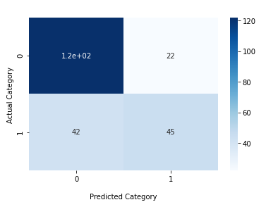
NB FINDINGS
We can see that among 231 observations 122 are those that were non-diabetic and is predicted as non-diabetic and 45 are those who had diabetes and is predicted as diabetic. And 64 observations are predicted wrong.
15

Slide 16
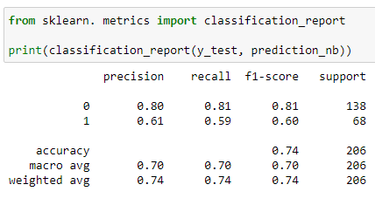
NB FINDINGS
Among all the patients who were non-diabetic trained model has predicted 80% as non-diabetic and other 20% are predicted as diabetic. Similarly, among those who were diabetic 61% of them are predicted as diabetic and the rest is predicted as non-diabetic
16

Slide 17
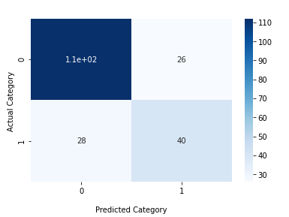
NB FINDINGS
Among 206 observations 112 are those that were non-diabetic and is predicted as non-diabetic and 40 are those who had diabetes and is predicted as diabetic. And 54 observations are predicted wrong
17

Slide 18
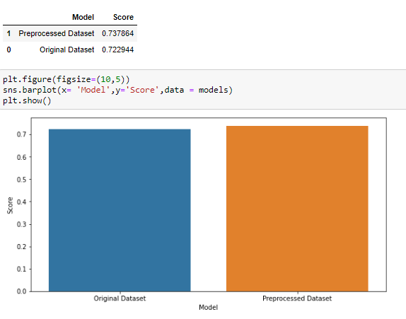
COMPARISON RESULTS
Original dataset has the accuracy of 72% and after removing the outliers from the dataset we have achieved more accuracy of 74%. This means that the data collected is not much authentic, performing parameters tuning on the data may also help in getting more accuracy
18

Slide 19

8. CONCLUSION & FUTURE WORK
19

Slide 20
CONCLUDING STATEMENT
It is possible to enhance the accuracy, precision, and recall, as well as the f1 Score, by removing the outliers.
The results achieved with Naïve Bayes is 72% accuracy on the original dataset.
The results achieved with Naïve Bayes is 74% accuracy on the processed dataset.
20
Notes:
The thesis presents a cost effective and adaptable blockchain solution for improving security, privacy and scalability of EHR systems.
The proposed blockchain-based EHR framework has been successfully implemented in Hyperledger Fabric.
The implementation is verified to work according to the description provided in this thesis and it can be concluded that the framework can draw benefits from an implementation in Hyperledger Fabric.

Slide 21
Thank You
21

